Slide 1

DATA ANALYSIS
By
Raghu Kotawar
03/02/2024

Slide 2
Introduction
As of 2022, the global Food & Grocery Retail market was estimated at USD 11895277.68 million.
Zomato is impacting major role to grow this industry.
Zomato is the leading delivery Partnership company

Slide 3
DATA OVERVIEW
INSIGHTS | VALUES
Total Number of Restaurants | 9551
Total average of Rating | 3.2
Total Number of voters | 31
Over all average expenditure on food | 820 Rupees
Most Frequent Price Range | 1

Slide 4
Methodology
Tools used –
Excel
Power Point
MS Word
Methodology used –
Conditional Formatting
Data Cleaning
Conditional Operator
Aggregator
Conditional Aggregator
Lookup Function
IS Blank, ISNA, Is Error functions
Array Function
Pivot
Graph

Slide 5
Objective
To Suggest Countries and opening new Restaurant
To Suggest Cities to open new Restaurant.
To show insights using visualization.
To find some key points which help to promote the business.

Slide 6
ANALYSIS AND INSIGHTS
IN 2018 TOTAL RESTAURANTS COUNT IS HIGHER COMPARING WITH ANOTHER YEARS
IN 2010 TOTAL RESTAURANTS COUNT IS LOW

Slide 7
ANALYSIS AND INSIGHTS
INDIA HAS THE HIGHEST NUMBER OF RESTAURANTS WITH 8652 COUNT
CANADA HAS THE LOWEST NUMBER OF RESTAURANTS WITH 4

Slide 8
ANALYSIS AND INSIGHTS
Highly recommended countries
Australia
Canada
Indonesia
Philippines
Qatar
Singapore
Sri Lanka

Slide 9
ANALYSIS AND INSIGHTS
Singapore has the highest expenditure on food
turkey has the lowest expenditure on food
Australia | 2007.59
Brazil | 2239.09
Canada | 3021.80
India | 623.37
Indonesia | 1462.19
New Zealand | 3472.85
Philippines | 273.16
Qatar | 5123.88
Singapore | 12983.32
South Africa | 1851.02
Sri Lanka | 665.00
Turkey | 218.07
United Arab Emirates | 3777.66
United Kingdom | 5028.92
United States of America | 2180.04

Slide 10
ANALYSIS AND INSIGHTS
Country | Average of Rating | Quality
Australia | 3.658333333 | Good
Sri Lanka | 3.87 | Good
Canada | 3.575 | Good
Indonesia | 4.295238095 | Awesome!
Philippines | 4.468181818 | Awesome!
Qatar | 4.06 | Awesome!
Singapore | 3.575 | Good
“<=1” is considered as “Bad”
<=2” is considered as “Below Average”
<=3” is considered as “Average”
<=4” is considered as “Good”
<=5” is considered as “Awesome!”

Slide 11
ANALYSIS AND INSIGHTS
PRICE RANGE | COUNT OF COUNTRY
1 | 4444
2 | 3113
3 | 1408
4 | 586

Slide 12
ANALYSIS AND INSIGHTS

Slide 13
ANALYSIS AND INSIGHTS
total restaurants with awesome! Quality are 1114
total restaurants with good Quality are 4388
total restaurants with average Quality are 1891
total restaurants with Below average Quality are 10
total restaurants with bad Quality are 2148

Slide 14
ANALYSIS AND INSIGHTS
TOTAL RESTAURANTS WITH TABLE BOOKINGS ARE 1158
TOTAL RESTAURANTS WITH NO TABLE BOOKINGS ARE 8393

Slide 15
ANALYSIS AND INSIGHTS
TOTAL RESTAURANTS WITH ONLINE DELIVERY ARE 2451
TOTAL RESTAURANTS WITHOUT ONLINE DELIVERY ARE 7100

Slide 16
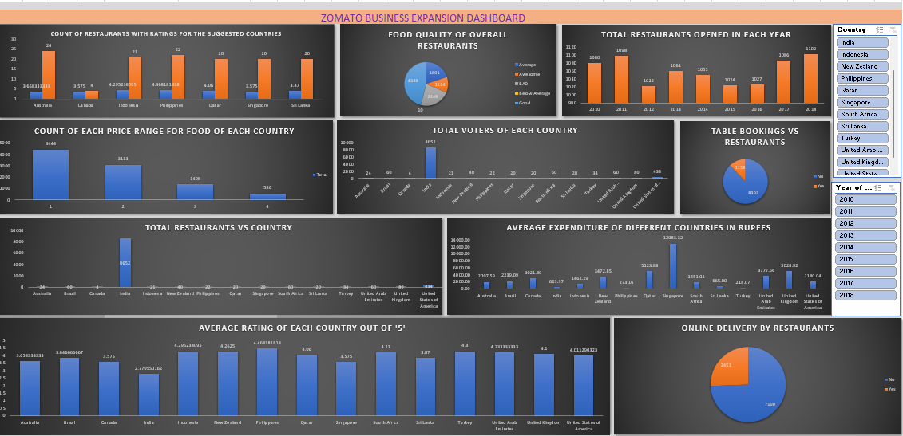
DASHBOARD

Slide 17
Future Outlook
FOLLOWING EACH SUGGESTED COUNTRY EXPENDITURE ON FOOD SO THAT THE FUTURE ANALYSIS CAN BE PERFORMED FROM THE ROOTS
VARIOUS DATA CLEANING METHODS ARE USED TO GRASP THE VARIOUS ANALYTICS AND INSIGHTS FROM THE DRIVEN DATASET
With its ambitious expansion plans and commitment to innovation, Zomato is poised for continued growth and success in the global food delivery market

Slide 18
CONCLUSION
If Average cost will Increase, rating will increase for the suggested countries. But same thing does not follow when we are taking all countries at once.
Restaurant with Online delivery and table booking has higher ratings.
Revealed patterns in the foundations for Expanding the Business across various countries that Included various aspects.
Focusing on the Cuisines that are of low feedback will make our business improved.
Price Range plays an important role in Getting customer Engagement for success.

Slide 19

THANK YOU……

